Slide 1
UNIT IV
Capital Budgeting

Slide 2
Outcome
Examine the concept of accounting rate of return and net present value in investment decision analysis.

Slide 3

News Analysis
https://www.thehindubusinessline.com/money-and-banking/aum-of-non-banks-to-revive-7-9-in-fy22-icra/article33511319.ece?homepage=true

Slide 4
Accounting Rate of Return (ARR)
The accounting rate of return (ARR), also known as the return on investment (ROI), uses accounting information, as revealed by financial statements, to measure the profitability of an investment.
The Accounting rate of return is the ratio of the average after tax profit divided by the average investment. The average investment would be equal to half of the original investment if it were depreciated constantly.

Slide 5
MCQ
Which of the following is not an advantage of the accounting rate of return (ARR) method of investment appraisal?
It takes into account the time value of money by allowing for depreciation in the equation
It is easy to understand
There is comparability between the ARR and the ROCE ratio used in financial accounting
The ratio takes account of the overall profit that is generated by the investment

Slide 6
Answer
It takes into account the time value of money by allowing for depreciation in the equation

Slide 7
Illustration
A project will cost ₹ 40,000. Its stream of earnings before EBDITA during first year through five years is expected to be ₹ 10,000; ₹ 12,000; ₹ 14,000; ₹ 16,000 and ₹ 20,000. Assume a 50% tax rate and depreciation on straight-line basis.

Slide 8
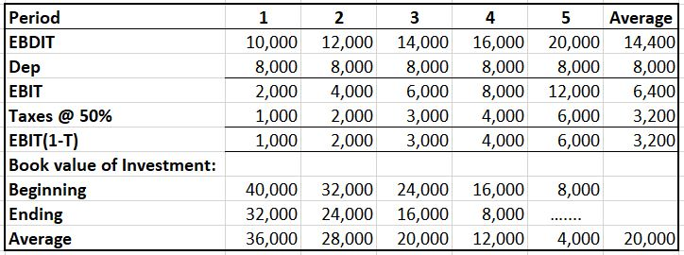
Solution

Slide 9
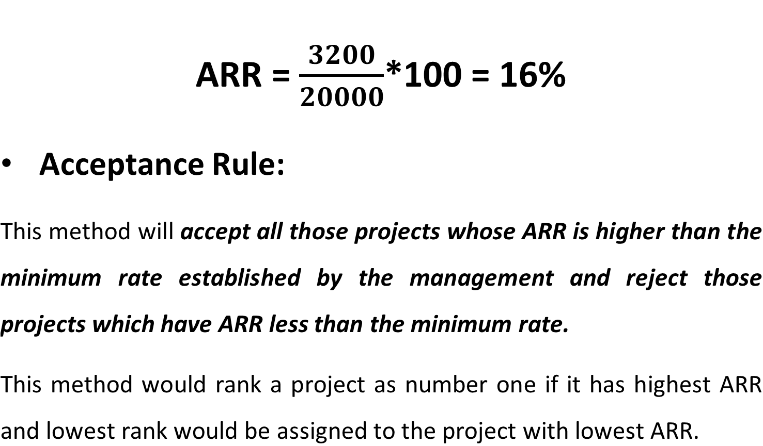
Contd….

Slide 10
MCQ
The accounting rate of return
Is synonymous with the internal rate of return.
Focuses on income as opposed to cash flows.
Is inconsistent with the divisional performance measure known as return on investment.
Recognizes the time value of money.

Slide 11
Answer
B. Focuses on income as opposed to cash flows.
The accounting rate of return (also called the unadjusted rate of return or book value rate of return) is calculated by dividing the increase in accounting net income by the required investment. Sometimes the denominator is the average investment rather than the initial investment. This method ignores the time value of money and focuses on income as opposed to cash flows.

Slide 12
Discounted Cash Flow (DCF) Techniques
DCF techniques are given as follows:
  Net Present Value (NPV)
  Internal Rate of Return (IRR)
  Profitability Index (PI)

Slide 13
Net Present Value (NPV) Method
The net present value (NPV) method is the classic economic method of evaluating the investment proposals. It is a DCF technique that explicitly recognizes the time value of money. It correctly postulates that cash flows arising at different time periods differ in value and are comparable only when their equivalents—present values—are found out.

Slide 14
Steps involved in NPV Calculation
Cash flows of the investment project should be forecasted based on realistic assumptions.
Appropriate discount rate should be identified to discount the forecasted cash flows.
Present value of cash flows should be calculated using the opportunity cost of capital as the discount rate.
Net present value should be found out by subtracting present value of cash outflows from present value of cash inflows. The project should be accepted if NPV is positive (i.e., NPV > 0).

Slide 15
MCQ
The net present value
Is calculated by discounting all cash flows to present value and subtracting outflows from inflows.
Calculates the rate of return which leaves you indifferent between undertaking the project, and not undertaking the project.
Leads to the same decisions as the use of the payback period.
Would suggest that we accept projects with a negative net present value.

Slide 16
Answer
Is calculated by discounting all cash flows to present value and subtracting outflows from inflows.

Slide 17
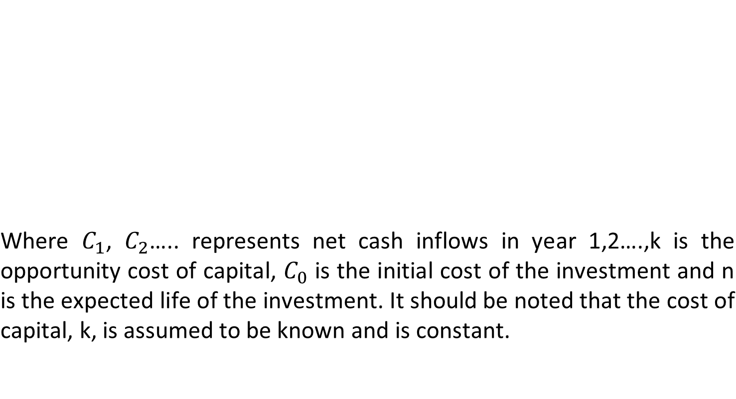
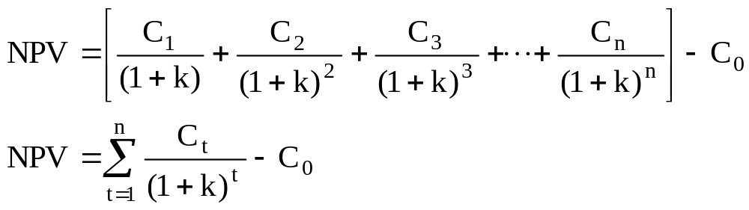
Formula for NPV Calculation

Slide 18
Illustration
Assume that Project X costs ₹ 2,500 now and is expected to generate year-end cash inflows of ₹ 900, ₹ 800, ₹ 700, ₹ 600 and ₹ 500 in years 1 through 5. The opportunity cost of the capital may be assumed to be 10 per cent. Calculate the net present value of the project X.

Slide 19
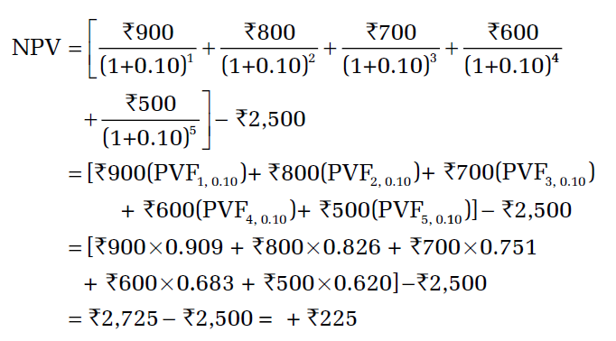
Solution
Project X’s present value of cash inflows (₹ 2,725) is greater than that of cash outflow (₹ 2,500). Thus, it generates a positive net present value (NPV = + ₹ 225). Project X adds to the wealth of owners; therefore, it should be accepted.

Slide 20
MCQ
The net present value of a project is equal to
The present value of all net cash flows that result from the project.
The present value of all revenues minus the present value of all costs that result from the project.
The present value of all future net cash flows that result from the project minus the initial investment required to start the project.
All of the above are correct.

Slide 21
Answer
D. All of the above are correct.

Slide 22
Significance of NPV
Positive net present value of an investment represents the maximum amount a firm would be ready to pay for purchasing the opportunity of making investment, or the amount at which the firm would be willing to sell the right to invest without being financially worse-off.
The net present value can also be interpreted to represent the amount the firm could raise at the required rate of return, in addition to the initial cash outlay, to distribute immediately to its shareholders and by the end of the projects’ life, to have paid off all the capital raised and return on it.

Slide 23
Acceptance Rule for NPV
Accept the project when NPV is positive (NPV > 0)
Reject the project when NPV is negative (NPV < 0)
May accept the project when NPV is zero (NPV = 0)
The NPV method can be used to select between mutually exclusive projects; the one with the higher NPV should be selected.

Slide 24
Evaluation of the NPV Method
NPV is most acceptable investment rule for the following reasons:
  Time value
  Measure of true profitability
  Value-additivity
  Shareholder value
Limitations:
  Involved cash flow estimation
  Discount rate difficult to determine
  Mutually exclusive projects
  Ranking of projects

Slide 25
MCQ
Assume that a firm has accurately calculated the net cash flows relating to two mutually exclusive investment proposals. If the net present value of both proposals exceed zero and the firm is not under the constraint of capital rationing, then the firm should __________.
Calculate the IRRs of these investments to be certain that the IRRs are greater than the cost of capital
Compare the profitability index of these investments to those of other possible investments
Calculate the payback periods to make certain that the initial cash outlays can be recovered within a appropriate period of time
Accept the proposal that has the largest NPV since the goal of the firm is to maximize shareholder wealth and, since the projects are mutually exclusive, we can only take one

Slide 26
Answer
D. Accept the proposal that has the largest NPV since the goal of the firm is to maximize shareholder wealth and, since the projects are mutually exclusive, we can only take one

